Slide 1
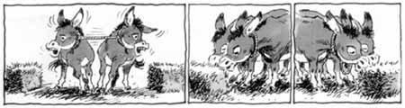
Why we all need to get along!
Agricultural Biotechnology Use all the tools in the toolbox
Martina Newell-McGloughlin
Director, International Biotechnology
Notes:
1

Slide 2
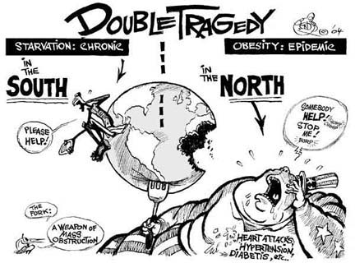
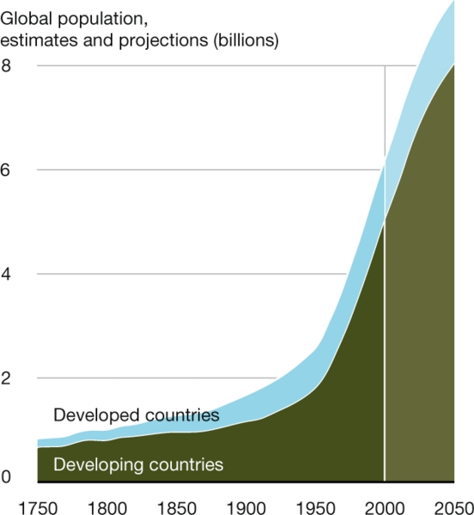
9 Billion mouths to feed by 2050
Will need 70% more food
Less water, less fuel, less fertilizer, less pesticides
High yielding, affordable, high quality food, feed, fuel, fibre sustainably produced with minimum inputs

Slide 3
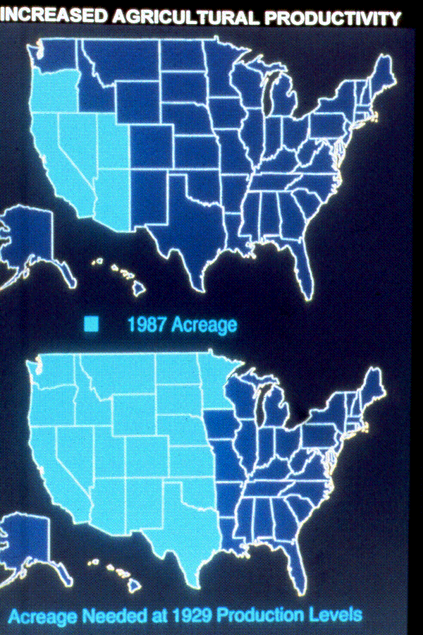
Food Security
High yielding, affordable, high quality food, feed, fuel, fibre with minimum inputs – 9 B 2050 – need 70% more food
17% of land under cultivation degraded by human activity 1945 to 1990. Ag land shrinks by 20,000 ha yearly. (World Bank)
Without yield increase land use will 2X by 2050.
Latin America: greatest yield increase had lower land use (less deforestation)
High yield “land sparing” better than “wildlife”-friendly inefficient land use farming (Green, Royal Soc. Bird Protection 2005)
Biotech is contributing by saving 108.7 million hectares from being converted to ag production (James, 2013).
1997 acreage

Slide 4
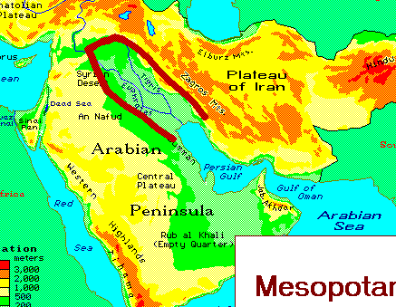
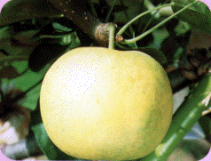
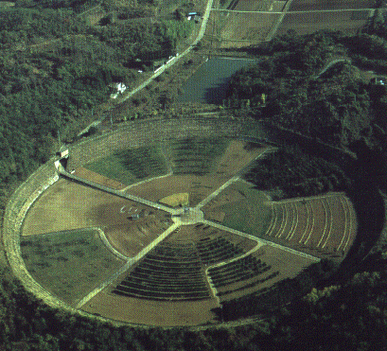
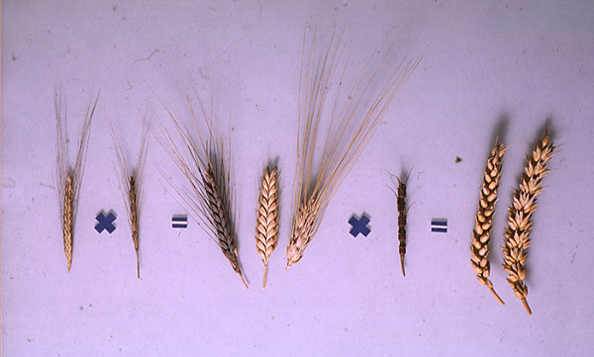
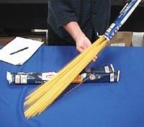
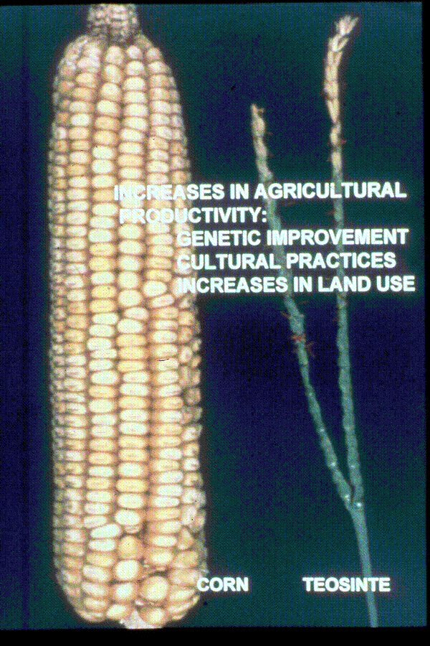

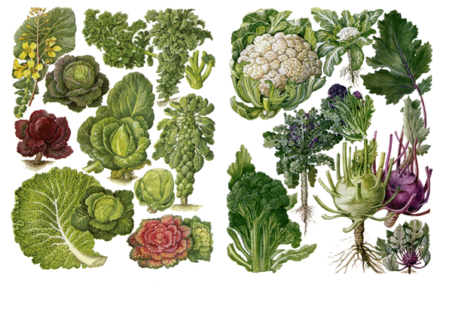

Agriculture: A history of Technology
8,000 BC
19thC
Ea 20th C
Md 20th C
1930s
1940s
1950s
1970s
1980
1990s
2000s
21st C
    Cultivation
    Selective Cross breeding
    Cell culture
    Somaclonal variation
    Embryo rescue
    Mutagenesis and selection
    Anther culture
    Recombinant DNA
    Marker assisted selection
    ---omics - Bioinformatics
    Epigenetics/RNAi/TFs/TALENS
    Adaptive technology/transgenomics
Systems Biology
Notes:
4
4

Slide 5
Relative Size of Genomic Introgression by Classical Breeding and Molecular genetics
0
1,000,000
2,000,000
3,000,000
4,000,000
5,000,000
Genome-wide analyses of introgression -oaks to fruit flies - substantial fraction of genomes malleable. Hybridization gives rapid genomic changes, chromosomal rearrangements, genome expansion, differential expression, and gene silencing (transposable elements). Baack 2008
Omic studies
Meta-analysis on GM crops using transcriptomic, proteomic and metabolomic profiling techniques show greater variation between conventional bred cultivars and environmental conditions (e.g. drought) than between GM and parental variety (except of course for the intended modification!) Ricroch AE, Bergé JB, & Kuntz M (2011). Wheat (Baker 2006), Potato (Catchpole 2005)

Slide 6
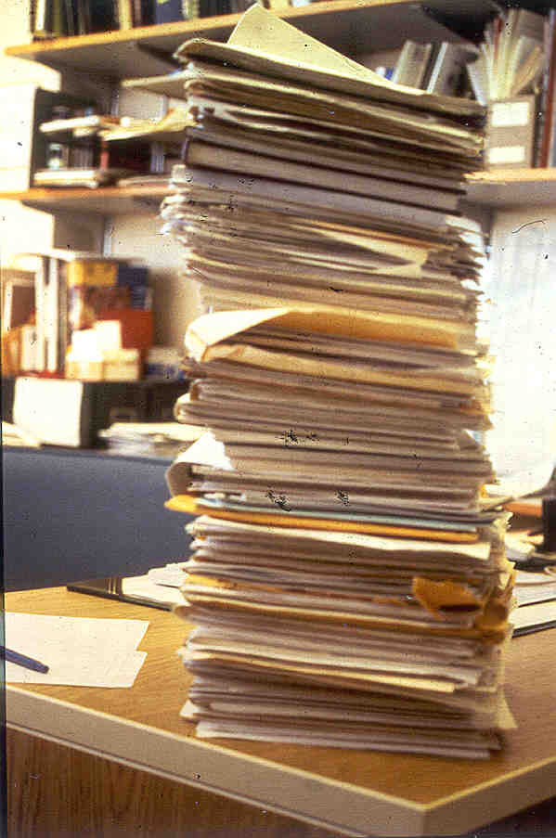
Thoroughly regulated
Commercialization: USDA (APHIS), EPA, FDA - 7 to 10 years -at least 9 review stages
Biotech crops and foods more thoroughly tested than conventional varieties ( “assumed” to be safe)- One biotech soybean subjected to 1,800 separate analyses
>150 feeding studies - dairy, beef, poultry, soy/corn equivalent in composition, digestibility and feeding value to non-GM.
Substantial equivalence with parent - Molecular characterization (17) Toxicity studies (5) - marker genes (4) - Nutritional content (7+)- Allergenicity potential - Anti-nutritional effects - Protein digestibility
Environmental aspects (5 items)- Ecological impact (5 items)
International approval: OECD, CBD, CODEX

Slide 7
Thoroughly regulated
Commercialization: 7 to 10 years -at least 9 review stages
Biotech crops and foods more thoroughly tested than conventional varieties ( “assumed” to be safe)- One biotech soybean subjected to 1,800 separate analyses
>150 feeding studies - dairy, beef, poultry, soy/corn equivalent in composition, digestibility and feeding value to non-GM.
Product description (7 items)
Molecular characterization (17 items)
Toxicity studies (as necessary) (5 items)
Antibiotic resistance marker genes (4 items)
Nutritional content (7+ items)
Substantial equivalence with parent variety
Literature review and background
Allergenicity potential
Similarity to natural toxicants
Anti-nutritional effects
Protein digestibility
Environmental aspects (5 items)
Ecological impact (5 items)

Slide 8
An estimated 2 trillion meals containing GM ingredients have been eaten around the world over the last 16 years without a single substantiated case of ill-health.
An overwhelming majority of scientists, medical experts, National Academy of Sciences and over 600 peer-reviewed scientific studies have all concluded that genetically engineered food products are safe.
The World Health Organization has said that: ‘No effects on human health have been shown as a result of the consumption of such foods by the general population.’
The French Academies of Medicine, Pharmacy & Sciences: “No evidence of health problems exists in the countries where GMOs have been widely eaten for several years”
EU: 25 years of Research 500 research groups over 25 years “There is no scientific evidence associating GMOs with higher risks for the environment or for food and feed safety than conventional plants and organisms”
Notes:
8

Slide 9
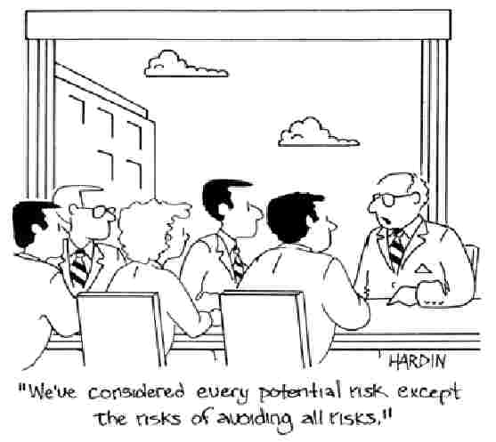
Risk Assessment
Precautionary Principle

Slide 10
On August 27, the United Kingdom Advisory Committee on Releases to the Environment (ACRE) produced three studies examining the structure and basis of the EU regulatory system for crops and foods improved through biotechnology.
Taken together, these reports demonstrate the existing EU regulatory system to be without justification in science, data, or experience.
ACRE concludes that, as presently administered, this regime is counterproductive to reducing or managing risks, and discourages investment and innovation needed to address challenges to sustainable agriculture in the EU.
Furthermore, ACRE states that the assumptions on which these regulations are based are contradicted by the patterns of genetic variation found abundantly in nature, and by the natural processes of genetic exchange and evolution through which they came to pass.
EU Position Changing
Notes:
10

Slide 11
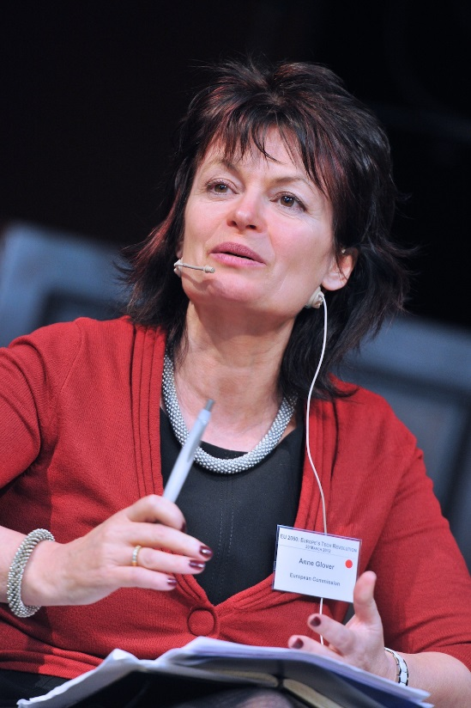

EU Position Changing
“There is no substantiated case of any adverse impact on human health, animal health or environmental health, so that’s pretty robust evidence, and I would be confident in saying that there is no more risk in eating GMO food than eating conventionally farmed food,” saying the precautionary principle no longer applies as a result. “GMOs and other scientific advances must be explored in order to head off the increasing scarcity of energy and other resources and competition for land use”
  Ann Glover EU Chief Science Advisor, 2013
'We believe that GM crops can help make agriculture more efficient and also just as importantly more sustainable, by, for example, reducing the use of pesticides and the use of fossil fuels,' he said.
  David Willets Minister of Science UK, 2013
  Read more: http://www.dailymail.co.uk/news/article-2341733/Now-Cameron-backs-genetically-modified-crops-prove-Britain-pro-science.html#ixzz2gJNpp3E6
  Follow us: @MailOnline on Twitter | DailyMail on Facebook

Slide 12
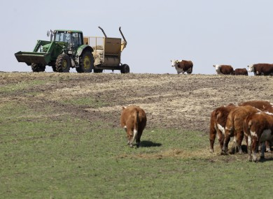
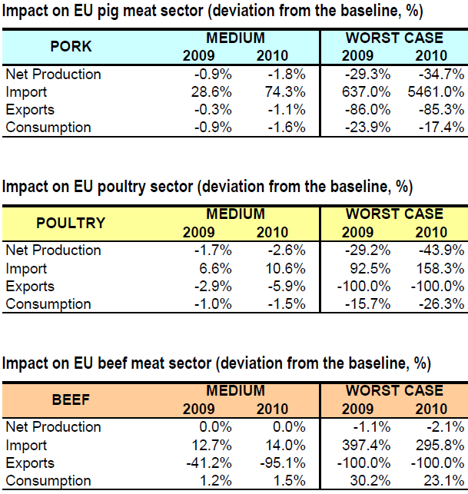
Europe is the loser
EU ag economy runs on cheap animal feed
Imports $15 billion in biotech animal feed each year
Livestock production accounts for 40% of the total value of agricultural production
2013 Ireland had long harsh winter
Limited fodder
Penalized from asynchronous approval of stacked traits
DG Agri Report
http://ec.europa.eu/agriculture/envir/gmo/economic_impactGMOs_en.pdf

Slide 13
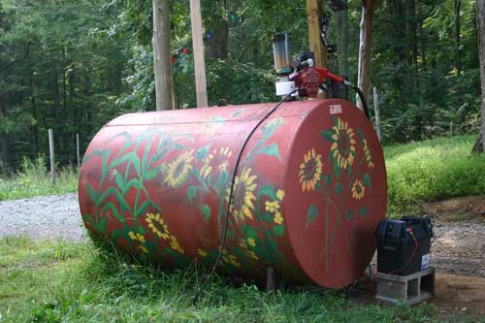
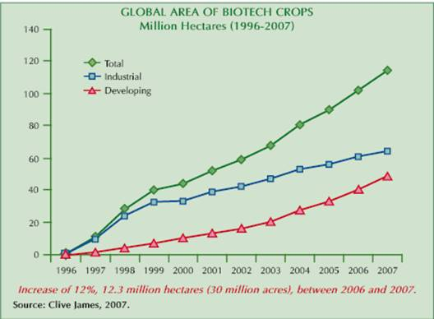
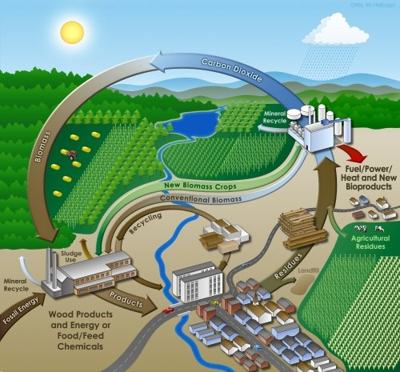
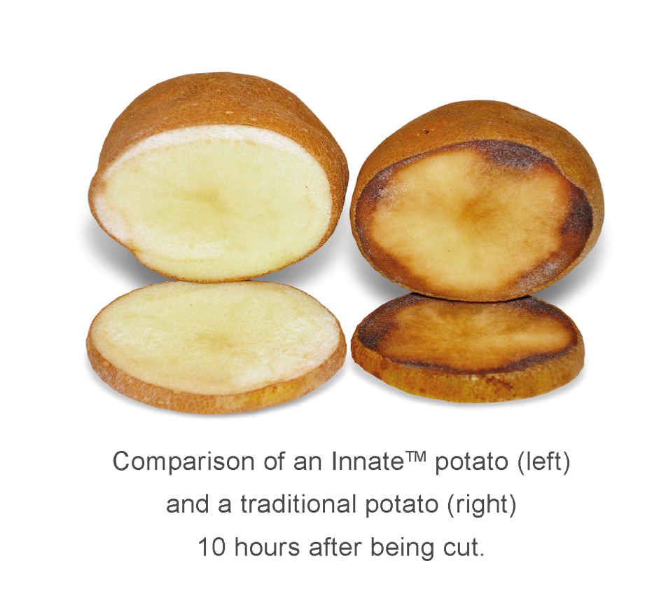
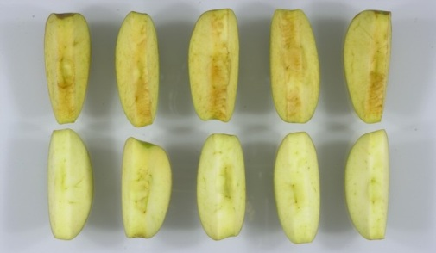
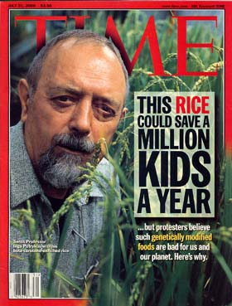
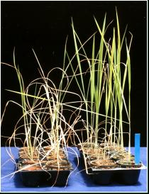
Opportunities/Challenges for Biotech Crops
CO₂
Renewable Resources Biomass conversion, feedstocks, biofuels, Phytoremediation Concerns land/ water use
Value
Plants as Factories Pharmaceuticals/ Industrial products (Ventria – Rice Lactoferin Lysozyme 30% Diarrhea, recovery 3/6 days, Concerns gene flow co-mingling
Quality Traits
Improved post harvest characteristics Shelf life, processing, taste Improved Nutrition –Improved Functionality Macro: protein, oils, carbs, fibre Micro: Vitamins, minerals, Phytochemicals – Antioxidants Remove Antinutrients/allergens/ Toxins
Agronomic Traits Biotic Stress - pests/disease/weeds/
Abiotic Stress: Drought, heat, salinity, submergence, marginal soils Yield: nutrient efficiency, fossil genes

Slide 14
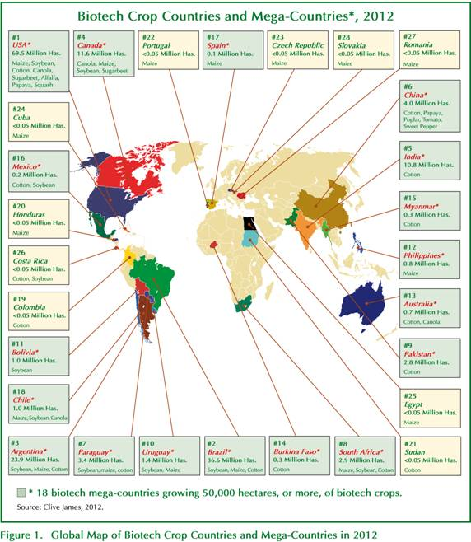
Biotech Crops 2012: 172 million hectares, up 10.2 million - 6% growth
US 69.5 Mhas (170Mac), (~90% principal biotech crops) -Canada 8.5MHacs (97.5%)
28 countries (20 LDC) 71% 17.3 M farmers 3.5% -90% (15M) resource-poor LDC
Two new Sudan (Bt cotton) and Cuba (Bt maize) – lost Germany Sweden Poland
26% of 420M ac stacked up from 105 M ac or 26% of the 395 M acs in 2011
Source: ISAAA
Notes:
14

Slide 15
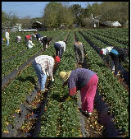
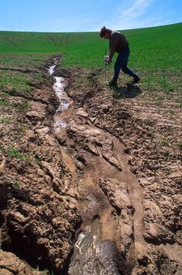
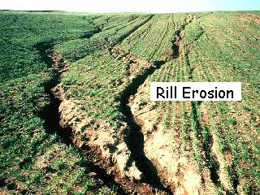
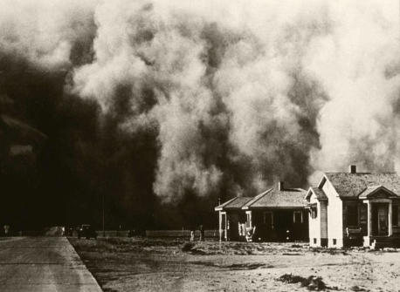
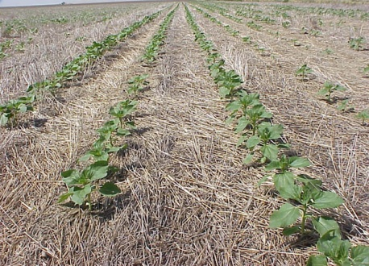
Environmental Impact
  Economic gains at the farm level of >$80 B 1996 to 2011
  1 billion lbs less pesticides
  HT Soybean – Conservation Tillage
  93% less soil erosion 31% less wind erosion
  Preservation of 1 billion tons of top soil
  70% reduction in herbicide run-off
  80% reduction in phosphorus in water
  >50% reduction in fuel use
  50 billion lbs reduction in CO2 emissions
  ~10 million cars off the road; saving 270 million acres of land; (Brookes and Barfoot, 2012)

Slide 16
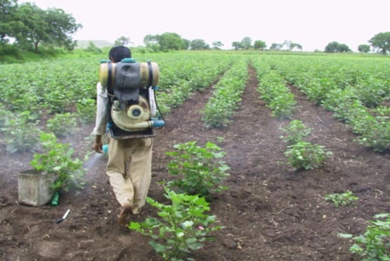
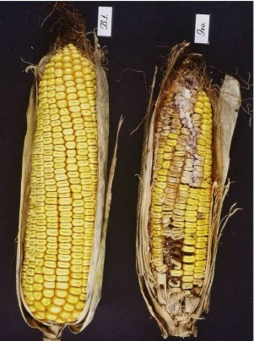
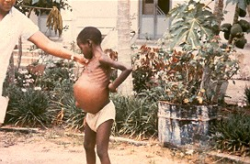
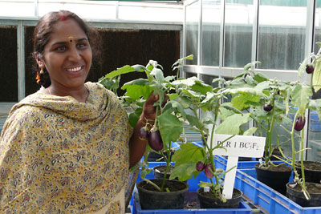

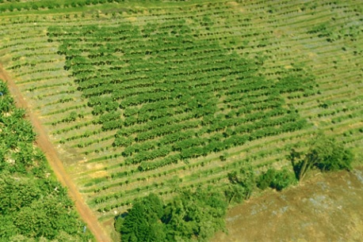
Benefits to Date
  BT Maize: Cumulative benefits over 14 years $3.2 - $3.6 billion >> $1.9 - $2.4 billion accruing to non-Bt maize growers. Hutchison , 2011
  BT corn 90% reduction in mycotoxin fungal fumonisins - total US benefit estimated at $23m annually (Wu, 2006)
  India Bt eggplant reduce insecticide use 40% and double yields
  Phytase maize – improved bioavailabilty of P and divalent ions increased nutrition – decreased
  PRSV CP papaya saved Hawaii papaya industry (and helped organic farmers!) May be the outcome for plum pox –C5 PTGS insurance against typhoid Mary in nurseries
Notes:
16

Slide 17
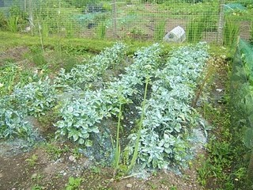

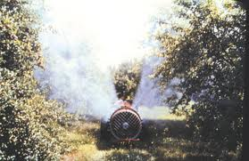
Guess the mystery substances ?

Slide 18
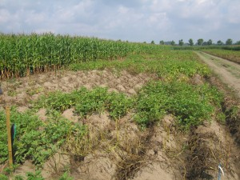
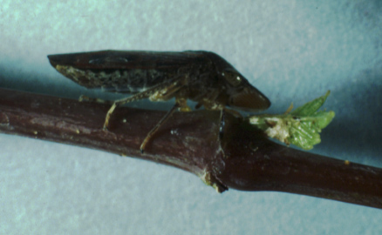
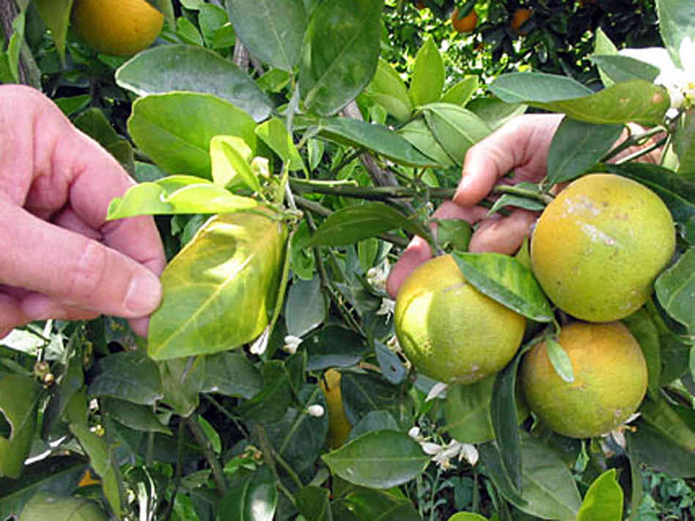
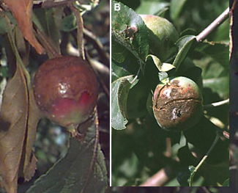
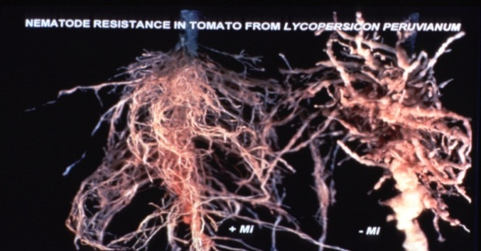
  Better Alternatives!
  Potato Late Blight - Up to 75% of crop can be lost – -Fortuna Resistant potato contains two genes from wild Mexican potato - eliminate fungicide spraying -potential saving $4.3 B – Plus Halo effect!
  Grapes- Pierce's disease (X. fastidiosa) - Fusion two genes innate immunity and membrane lysis – preferable to spraying malathion! (Dandekar)
  Citrus Greening (C. Liberibacter) – Biotech the only solution 2 spinach genes – showing field R Mirkov 2013
  Apple Fireblight (E. amylovora) – controlled using antibiotic sprays! Cecropin lytic peptide analog (Norelli)
  Apple scab (V. inaequalis) Fungicides 'MacIntosh' trees endo- or exochitinase increased resistance
  Rootknot nematodes R in tomato (Mi) and (aphids). Alternate to fumigation (Williamson
Notes:
18

Slide 19
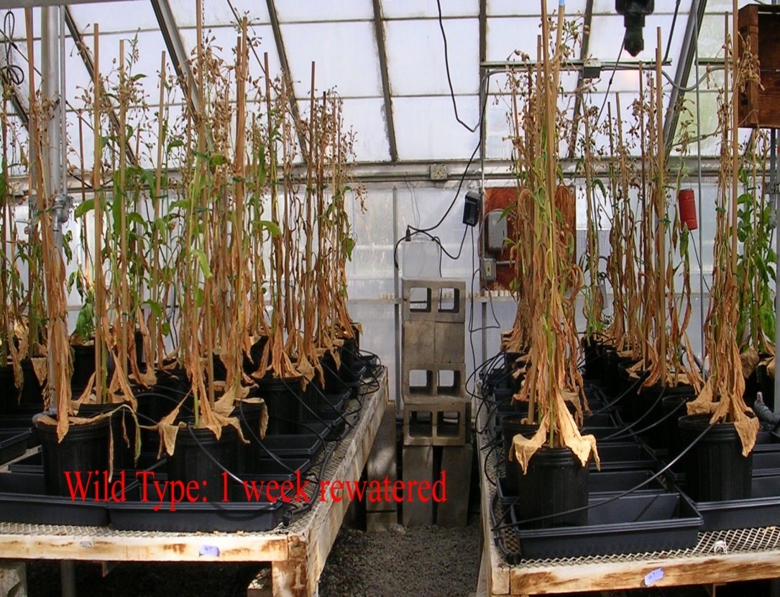
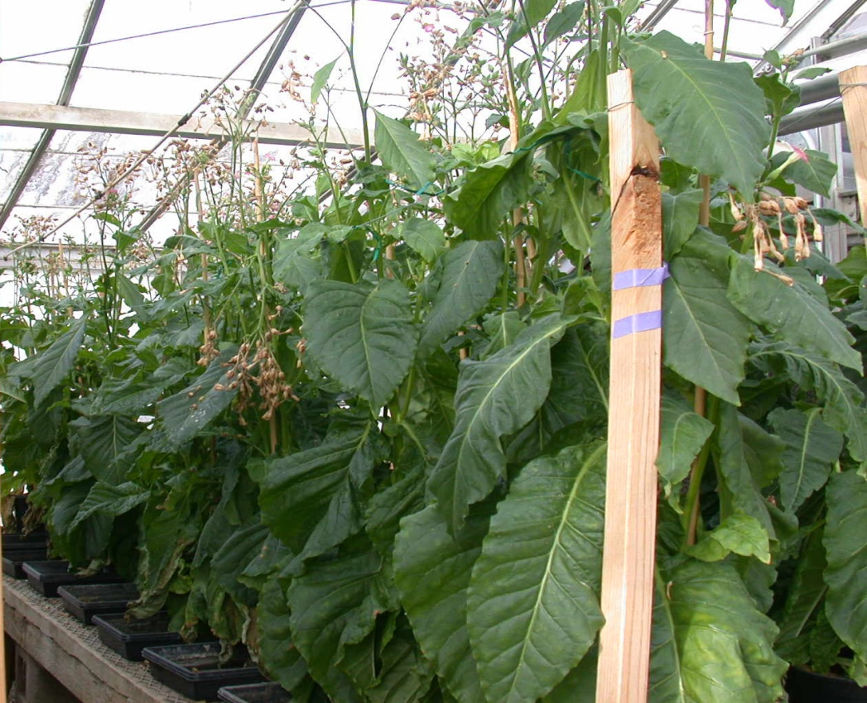
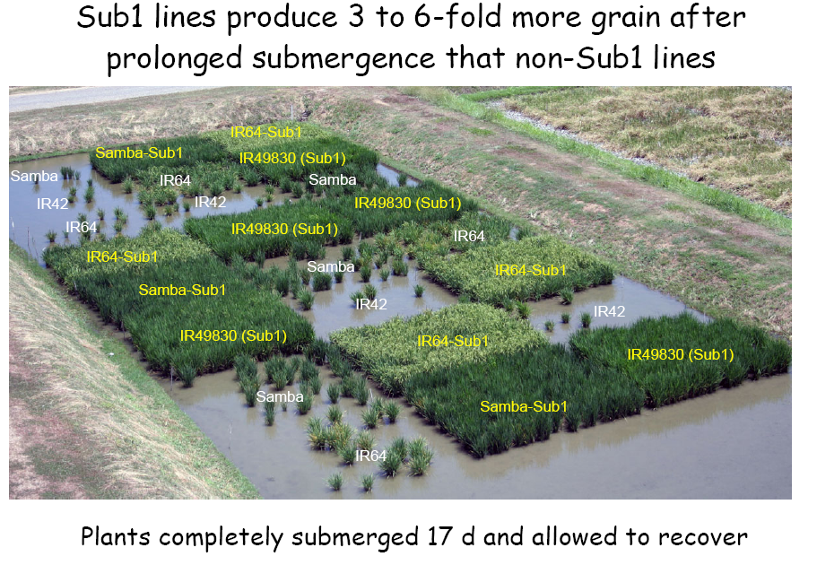
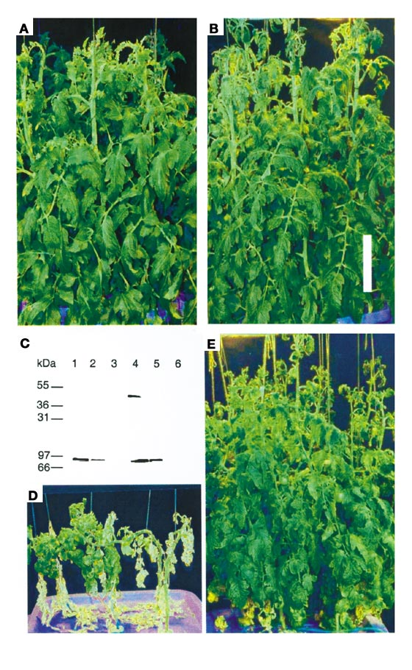
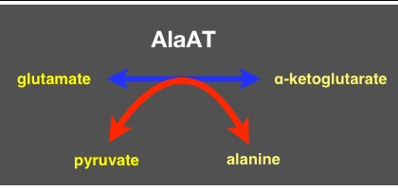
Abiotic Stress:
Drought, Cold, Heat, Salinity
Abiotic stress limiting factor to crops reaching genetic potential
  Drought tolerant maize ( 30% increase in field trials under H2O stress) Fewer crop losses -Higher yields better water utilization
  “Resurrection” gene delay drought-induced leaf loss and stress
  Submergence sub -1 gene produces 6X grain - save 3 mil tons rice ( save 40 mil people)
  Salination: Transport protein. Grow and fruit even in irrigation water that is > 50X saltier than normal. > 1/3 seawater. Blumwald and Zhang)
  Arcadia's Nitrogen Use Efficiency (NUE) plants equivalent yields require 30% less Nitrogen fertilizer greater efficiency
Wild type IPT gene
15 days drought, 7 days re-watered
Notes:
19
Grower Benefits:
Improved stress tolerance allows earlier planting and further reduces yield variability and grower financial risk
70-80 million acres in US suffer yield losses due to moderate water stress.
The most critical time for water stress is near pollination and flowering. e.g. yields with or without irrigation can vary 100%. Dry land acres (Kansas) can yield less than 100 bu/a without irrigation and 200 bu/acre with irrigation.
About 15% of US corn acres are irrigated. A lot more acres would grow corn if yields were higher due to drought tolerance. About 20 million acres in US would benefit from a drought tolerance gene that gives a 10% yield increase. An additional 5 million acres could move from some other crop to corn if we had drought tolerance. On these new acres we would capture 100% of new units sold and associated trait fees etc.
Science:
Gene C source is transcription factor from arabidopsis. Found in arabidopsis screens. In the process of moving this gene into crops.
Gene D is a different gene from microbial sources which confers broad stress tolerance to cold, heat and drought. What we show here is drought tolerance.
Water availability and temperature stress are major causes of yield loss
We use our Genomics platform to screen for genes which reduce yield loss under these conditions
The bottom right pictures show target genes in Rice plants under common stress conditions

Slide 20
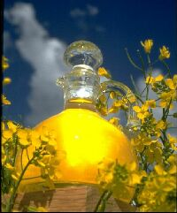
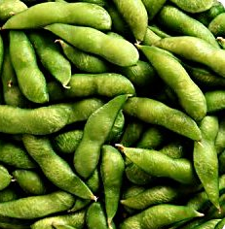
  Healthy Potatoes
  Reduced asparagine reduces the potential for the formation of acrylamide by 80%, created when potatoes, wheat, coffee, etc cooked at high temperatures.
  Reduced black spot from bruising and Browning RNAi suppression of Polyphenol oxidase (PPO)
  Reduced sugars which provide potatoes with a consistent golden color, providing ideal taste texture qualities
  Healthy Oils
  High Omega 3 fatty acids – right now fatty fish only source – With biotech soybeans etc can provide a land-based source making it more affordable and accessible!
  Also high oleic and high stearate/low saturated soybean oil
Notes:
20

Slide 21

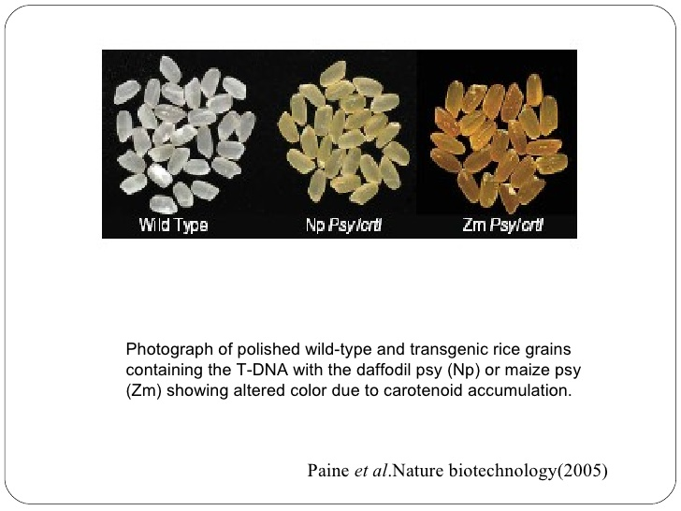
Golden Rice
Vitamin A is multi-functional
  critical component of vision.
  plays a significant role in the immune system
  crucial for growth and development
It is a disease primarily of poverty, killing 1.9-2.8 million people annually, mostly children under 5 and women.
Golden Rice with genes for β-carotene -200g provides daily requirements to offset deficiency
Cheaper, easier to distribute and more sustainable than other sources

Slide 22
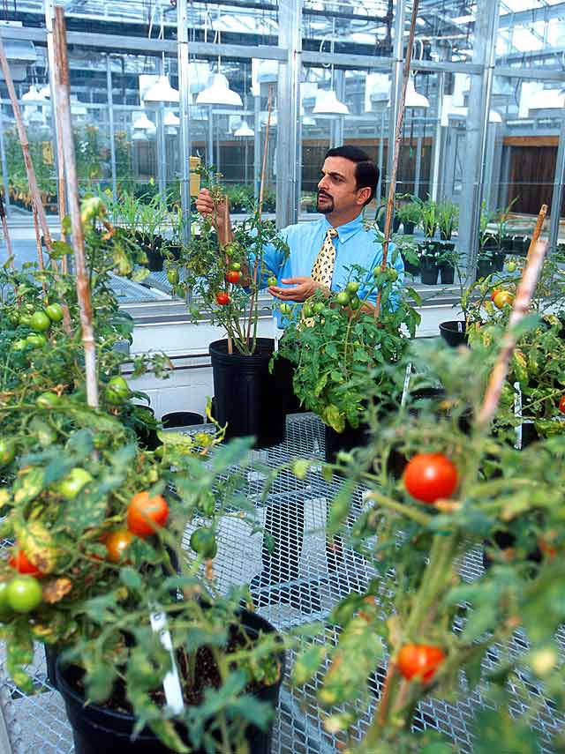







Improved Nutritional Content
Many common food crops not perfect for nutritional requirements.
Proteins: Maize, wheat, Sweet potato and cassava
WHO: 800 million people suffer from malnutrition, Protein-energy malnutrition (PEM), the most lethal form, affects 1 in 4 children: 70% live in Asia, 26% Africa, 4% Latin America, Caribbean
Functional Foods: benefits beyond basic nutritional needs.
Macro: Protein (Better ratio, High lys/ meth, Fossil TF partitioning, artificial)
  Carbohydrates (>complex – resistant starch )
  Fats (Higher Oleic (MUFA), Ω-3, Ω- 6 GLA, CLA, MCFA, lower SFA, PUFA
  Fibre (low for animals, high for humans (prebiotics, FOS, inulins, lignans)
Micro: Vitamins (Golden rice II, Golden Cassava, folate, vit C, vit E), co-factors, minerals (Vine-ripe tomatoes GLK2 TF that controls chloroplast controls sugars/soluble solids, lycopene (Powell)
Phytochemicals: anthocyanins carotenoids, flavonoids, isoflavones, isothiocyanates, phenolics (Sirtuins)
Anti-nutrients: Trypsin inhibitors, Phytate; caffeine
Allergens/intolerance: soy P34, peanut; gluten;
Toxins: glycoalkaloids, cyanogenic glucosides, phytohaemagglutinins

Slide 23



Things that may disappear without biotech
  Papaya
  No natural resistance so traditional breeding will not work
  Removes viral reservoir thus protects all growers
  Orange Juice
  Citrus Greening – bacterial disease
  Spinach genes can save from annihilation
  Bananas
  Fungal, viral & bacterial diseases threatening clonal Cavendish banana – need biotech to save variety
  Grapes
  Pierce's disease spread by glassy wing sharp-shooter –
  Resistant gene preferable to spraying malathion to control vector
Notes:
23

Slide 24



Cooperation works
Organic Blue Cornfield near yellow non-organic field Fred Yoder Ohio
Biotech Corn
Organic Corn
No cross pollination (no blue kernels)
No yellow kernels
Many crops containing diverse market types co-exist: Sweet corn and field corn seed production - Oil and confectionary sunflower seed production- Canola and rapeseed production - Diverse types of rice, cotton, etc\
Zero-tolerance is extremely difficult to attain. Co-existence is not possible without pragmatic proportional thresholds. Spain and Czech Rep make it work
In the seed industry, the producer seeking higher purity for a higher value product has accepted responsibility for meeting the market expectations
US organics cannot be (legally) downgraded or growers decertified by unintentional presence no producer has been so impacted to date
Notes:
Do buffers work? Does altering planting dates and maturities work? Here is some proof.
The first two pictures that you will see are organic ONLY. This first picture is just an
> ear of blue corn, adjacent to a yellow corn field---just to show no
> cross pollination (of color anyway), even though the fields are
> adjacent.

Slide 25
Professional Scientific and/or Medical bodies with an opinion on safety of GMOs
Generally Positive
The U.S. National Research Council (NRC)
U.S. National Academy of Sciences (NAS)
The American Medical Association, (AMA)
U.S. Department of Agriculture (USDA)
U.S. Environmental Protection Agency (EPA)
U.S. Food and Drug Administration (FDA)
European Food Safety authority (EFSA)
American Society for Plant Biology (ASPB)
World Health Organization (WHO)
Food and Agriculture Organization (FAO)
Royal Society (London)
Brazil National Academy of Science,
Chinese National Academy of Science
Indian National Academy of Science
Mexican Academy of Science
Third World Academy of Sciences
Generally Negative

Slide 26


I hope that there is nothing
genetically modified in this
Greatest Challenges going forward
Technical
Intellectual Property: PIPRA - Specialty crops – FTO
Liability ( Coexistence – need reasonable thresholds)
Regulations: Asynchrony – Lack of uniformity LDCs/ Specialty
Acceptance: - countering fear and misinformation (ethical) - moral imperative real need v. hypothetical risk
Notes:
26

